Slide 1
15
Cost of Capital

Slide 2

Chapter 15 – Index of Sample Problems
Slide # 02 - 07 Cost of equity
Slide # 08 - 09 Cost of preferred
Slide # 10 - 15 Cost of debt
Slide # 16 - 19 Portfolio weights
Slide # 20 - 23 Weighted average cost of capital (WACC)
Slide # 24 - 27 Flotation costs

Slide 3
2: Cost of equity
Isabelle Thomas and Son, Inc. just paid the annual dividend on their common stock in the amount of $1.20 per share. The company expects to maintain a constant 3% rate of growth in their dividend payments. Currently, the stock is selling for $20.40 a share.
What is the cost of equity for Isabelle Thomas and Son, Inc.?

Slide 4
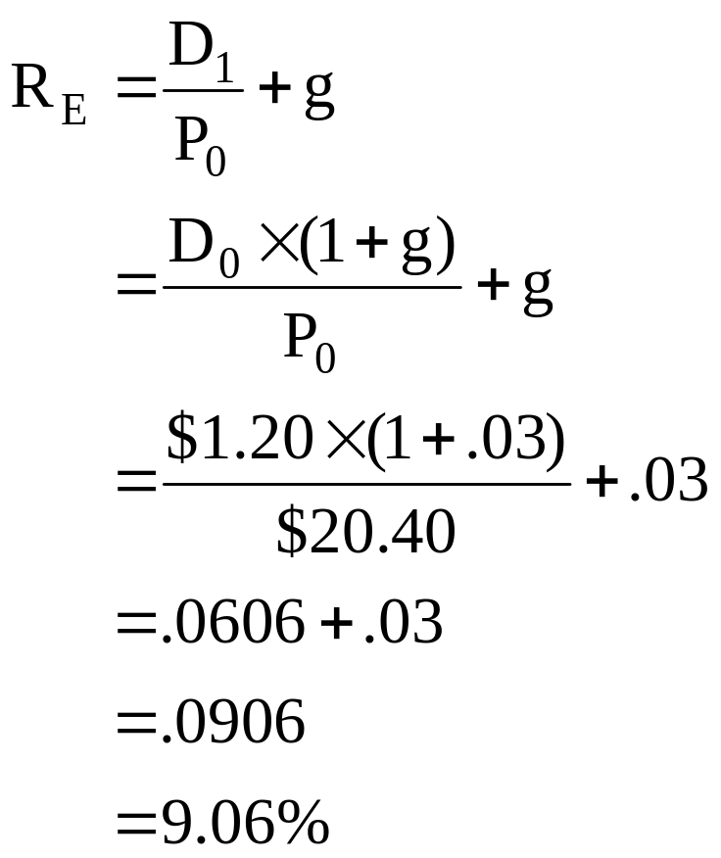
3: Cost of equity

Slide 5
4: Cost of equity
The Curtis Plane Co. has paid $1.10, $.90, $.83 and $.75 in annual dividends over the past four years, starting with the latest year first. This year the company is paying a dividend of $1.22 a share.
What is the average growth rate of the dividends?

Slide 6
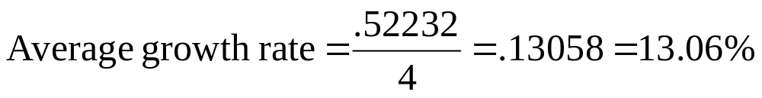
5: Cost of equity
$1.22 | ($1.22 - $1.10) ÷ $1.10 = | .10909
$1.10 | ($1.10 - $.90) ÷ $.90 = | .22222
$ .90 | ($.90 - $.83) ÷ $.83 = | .08434
$ .83 | ($.83 - $.75) ÷ $.75 = | .10667
$ .75 | --- | ---
 | Total | .52232

Slide 7
6: Cost of equity
The stock of Neal & Co. has a beta of 1.40. The risk-free rate of return is 3.5% and the risk premium is 8%.
What is the expected rate of return on Neal & Co. stock?

Slide 8
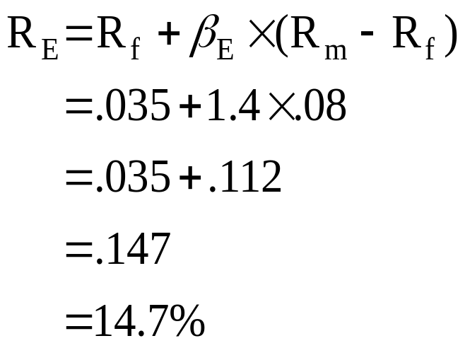
7: Cost of equity

Slide 9
8: Cost of preferred
The 7% preferred stock of Anderson, Inc. is selling for $72.92.
What is the cost of preferred stock?

Slide 10
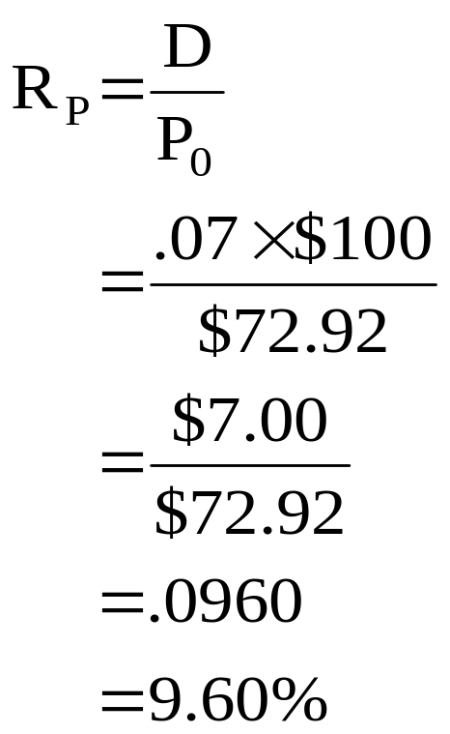
9: Cost of preferred

Slide 11
10: Cost of debt
The bonds of TA, Inc. have a face value of $1,000 per bond, mature in 13 years, and pay 8% interest annually. These bonds currently sell for $969.08.
What is the pre-tax cost of debt?

Slide 12
11: Cost of debt
Enter 13 ±969.08 80 1,000
N I/Y PV PMT FV
Solve for 8.4

Slide 13
12: Cost of debt
Four years ago, JE, Inc. issued twenty-year bonds that have a face value of $1,000 per bond and pay interest semi-annually. These bonds currently sell for $1,012.30 and have a 9% coupon.
What is the pre-tax cost of debt?

Slide 14
13: Cost of debt
Enter (20-4)×2 /2 ±1,012.30 90/2 1,000
N I/Y PV PMT FV
Solve for 8.85

Slide 15
14: Cost of debt
The pre-tax cost of debt for Morrison and Sons is 8.78%. The tax rate is 35%.
What is the after-tax cost of debt for Morrison and Sons?

Slide 16
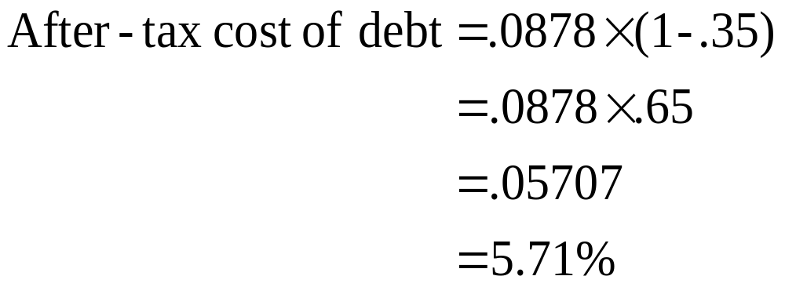
15: Cost of debt

Slide 17
16: Portfolio weights
Wilson and Ruth, Inc. has 720,000 shares of common stock outstanding at a market price of $32.10 per share. They also have 50,000 shares of preferred stock outstanding at a price of $45 a share. The company has 20,000 bonds outstanding that are currently selling at 98% of face value and mature in 9 years. The bonds carry a 6% coupon and pay interest annually. The bonds have a face value of $1,000. The tax rate is 34%.
What are the portfolio weights that should be used in computing the weighted average cost of capital?

Slide 18
17: Portfolio weights
Common stock (E) | 720,000 × $32.10 | $23,112,000 | 51.4%
Preferred stock (P) | 50,000 × $45.00 | $ 2,250,000 | 5.0%
Debt (D) | 20,000 × $1,000 × .98 | $19,600,000 | 43.6%
Totals (V) |  | $44,962,000 | 100.0%

Slide 19
18: Portfolio weights
The Winston James Co. has a debt-equity ratio of .65. The company has no preferred stock outstanding.
What is the portfolio weight of the debt?

Slide 20
19: Portfolio weights
Debt/equity = .65
Weights
Debt = .65 .65 ÷ 1.65 = .3939 = 39.39%
Equity = 1.00 1.00 ÷ 1.65 = .6061 = 60.61%
Value = 1.65 Total = 1.0000 100.00%

Slide 21
20: Weighted average cost of capital
A firm has a debt-equity ratio of .45 and a tax rate of 34%. The cost of equity is 9.4% and the pre-tax cost of debt is 8%.
What is the weighted average cost of capital?

Slide 22
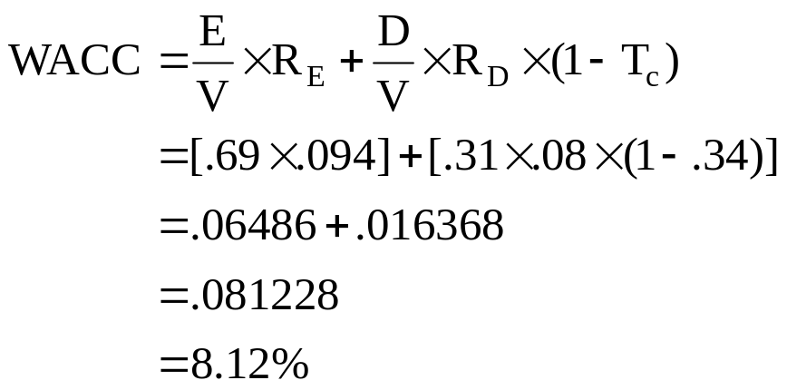
21: Weighted average cost of capital
Debt = .45 .45 ÷ 1.45 = .31
Equity = 1.00 1.00 ÷ 1.45 = .69
Value = 1.45 Total = 1.00

Slide 23
22: Weighted average cost of capital
Merilee, Inc. maintains a capital structure of 40% equity, 15% preferred stock and 45% debt. The cost of equity is 12% and the cost of preferred is 9%. The pre-tax cost of debt is 8%. The tax rate is 35%.
What is the weighted average cost of capital?

Slide 24
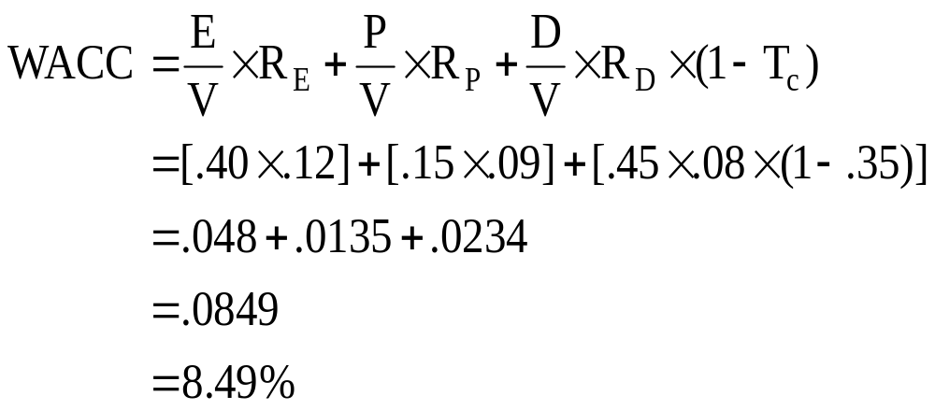
23: Weighted average cost of capital

Slide 25
24: Flotation costs
The Silow Co. maintains weights of 55% equity, 10% preferred stock and 35% debt. The flotation costs are 8% for equity, 9% for preferred and 4% for debt.
What is the weighted average flotation cost?

Slide 26
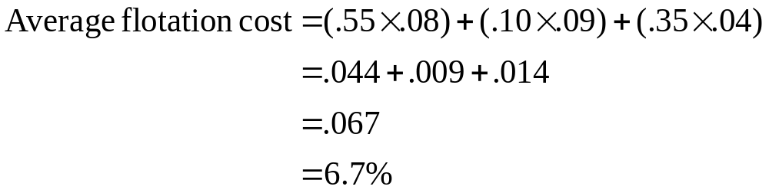
25: Flotation costs

Slide 27
26: Flotation costs
Your company maintains a debt/equity ratio of .60. The flotation cost for new equity is 12% and for debt it is 6%. The firm is considering a new project which will require $5 million in external funding.
What is the initial cost of the project including the flotation costs?

Slide 28
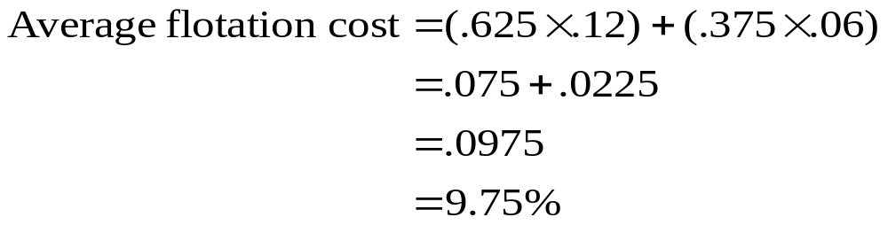
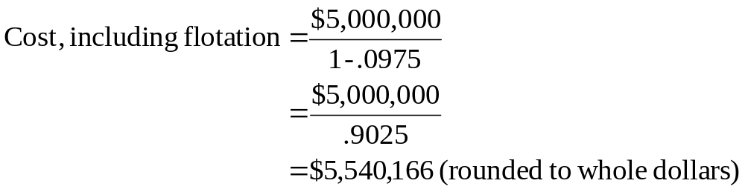
27: Flotation costs
Debt = .60 .60 ÷ 1.60 = .375
Equity = 1.00 1.00 ÷ 1.60 = .625
Value = 1.60 Total = 1.000

Slide 29
15
End of Chapter 15

